Slide 1
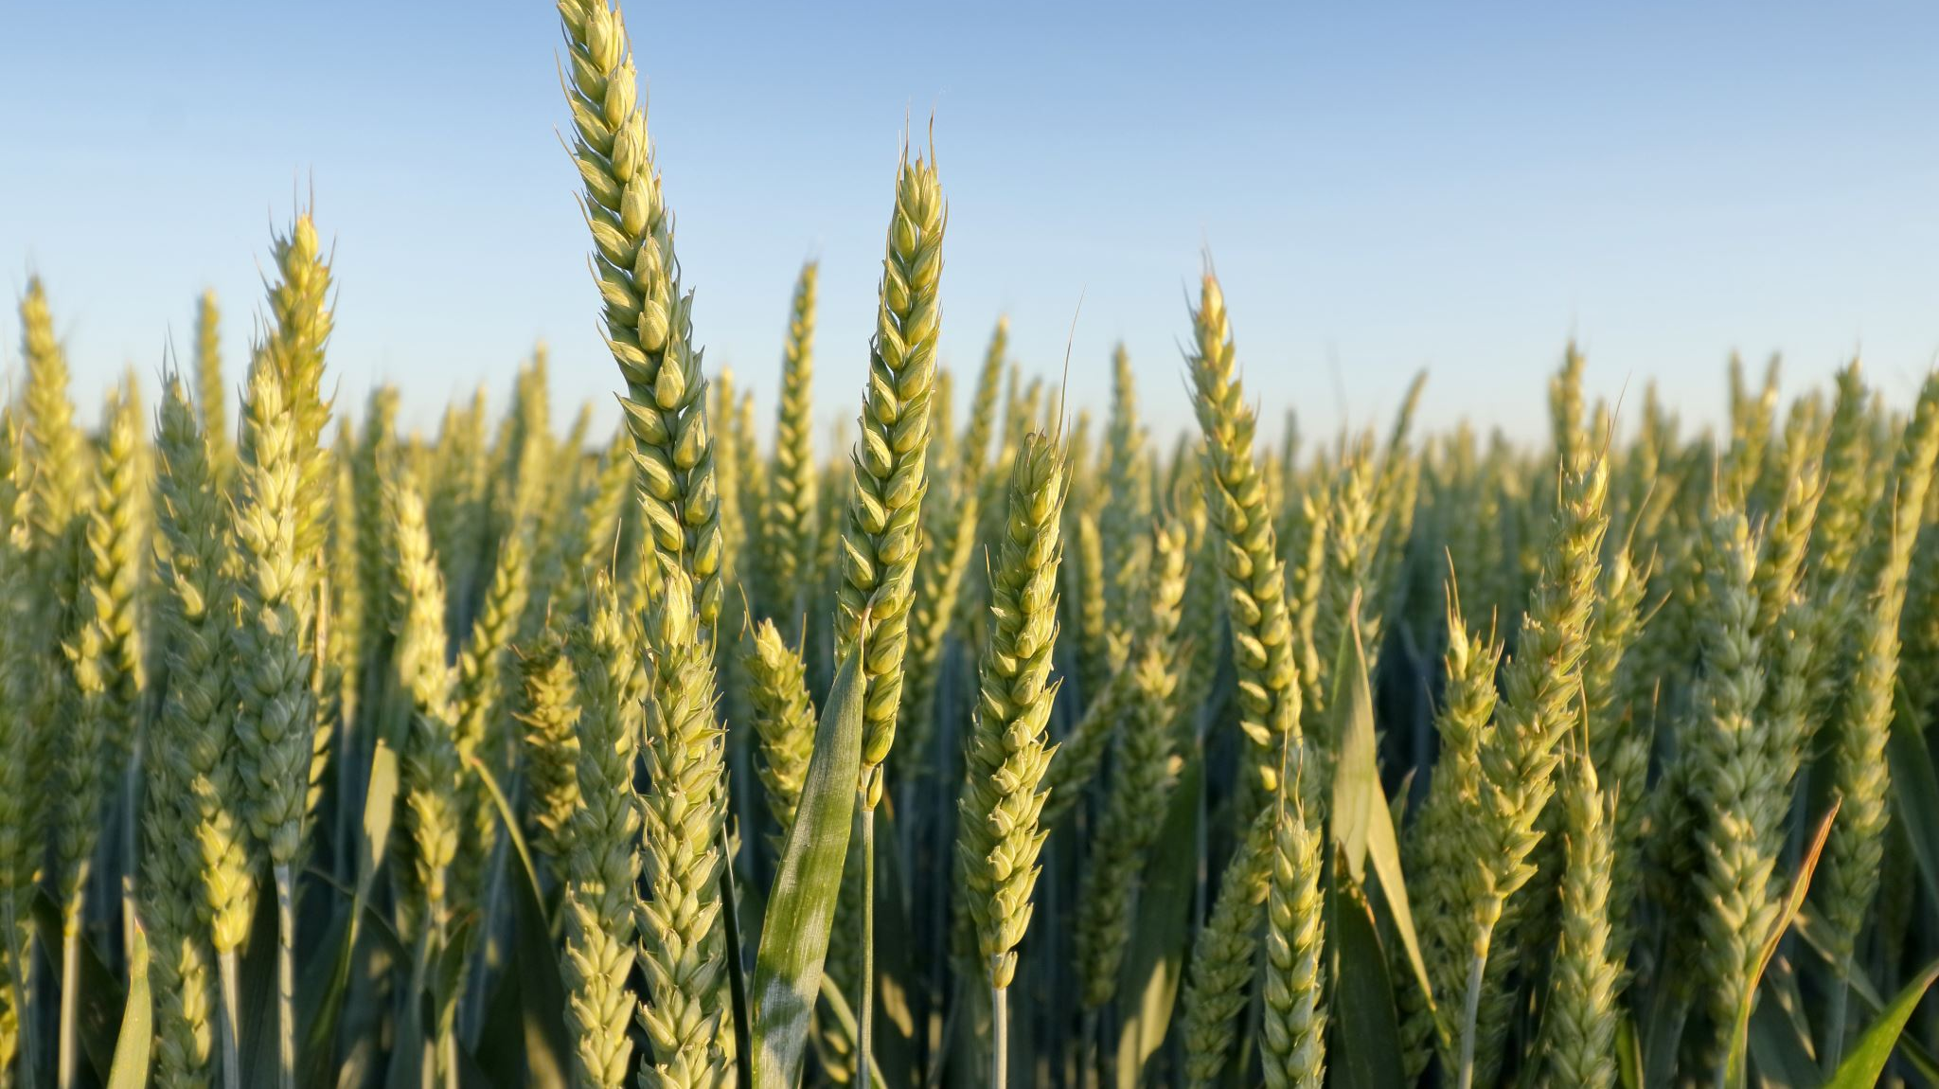
Agronomy CDE Workshop
2024 KACTE Workshop

Slide 2
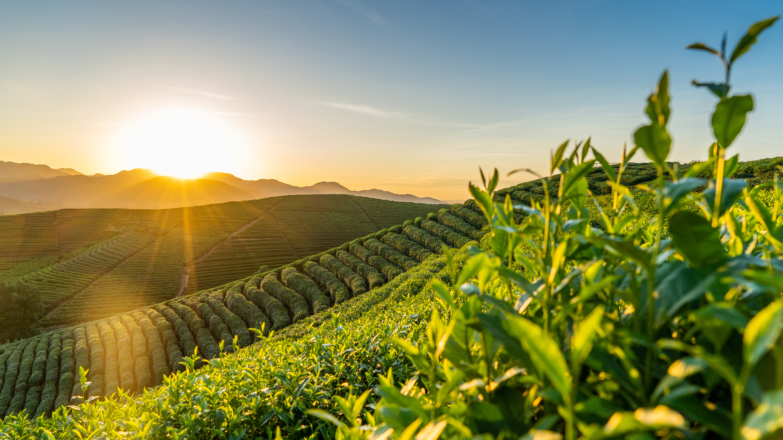
New Rules for 2025 Agronomy CDE
ID will move from a 100-question quiz to a 75-question quiz, still completed in 40 minutes. Each ID sample will now be worth 4 points.
Vegetative weeds will be transferred to the ID rotation instead of the Practicum, where they are currently placed.
The form of the plant that is acceptable for the contest will be indicated on the ID list as "p" - pressed or in reproductive phases, "v" - live, vegetative (no flowers, fruits, etc), and "s" - seed.
The group was of the strong opinion that seed analysis and grain grading are no longer a relevant portion of the FFA contest. GG will remain a potential component of lab practical questions in a simplified form, so students should still be able to read a grain grading card and assign grades based on tables.

Slide 3
New Rules for 2025 Agronomy CDE
The lab practical component will be split into two separate rotations:
Identification of insects, diseases, and equipment
Applied agronomics
crop science (crop development, botany, nutrient deficiencies, etc), soil science (texture triangles, soil tests, tillage, etc), and practical management questions (i.e. what practice would be helpful here, what should have been done differently, why is this done, etc).
These categories of questions are the same as what is currently combined into the "Practicum" part of the contest but will create more distinct sections to facilitate teaching/studying strategies for students.
To facilitate this split in practical rotations, John Kern has offered to head up a group to rework the Kansas ID lists (crops, weeds, equipment, insects, diseases, etc.) to beef them up a bit for the new style of practical rotations, align them with the national list, and generally update them.

Slide 4
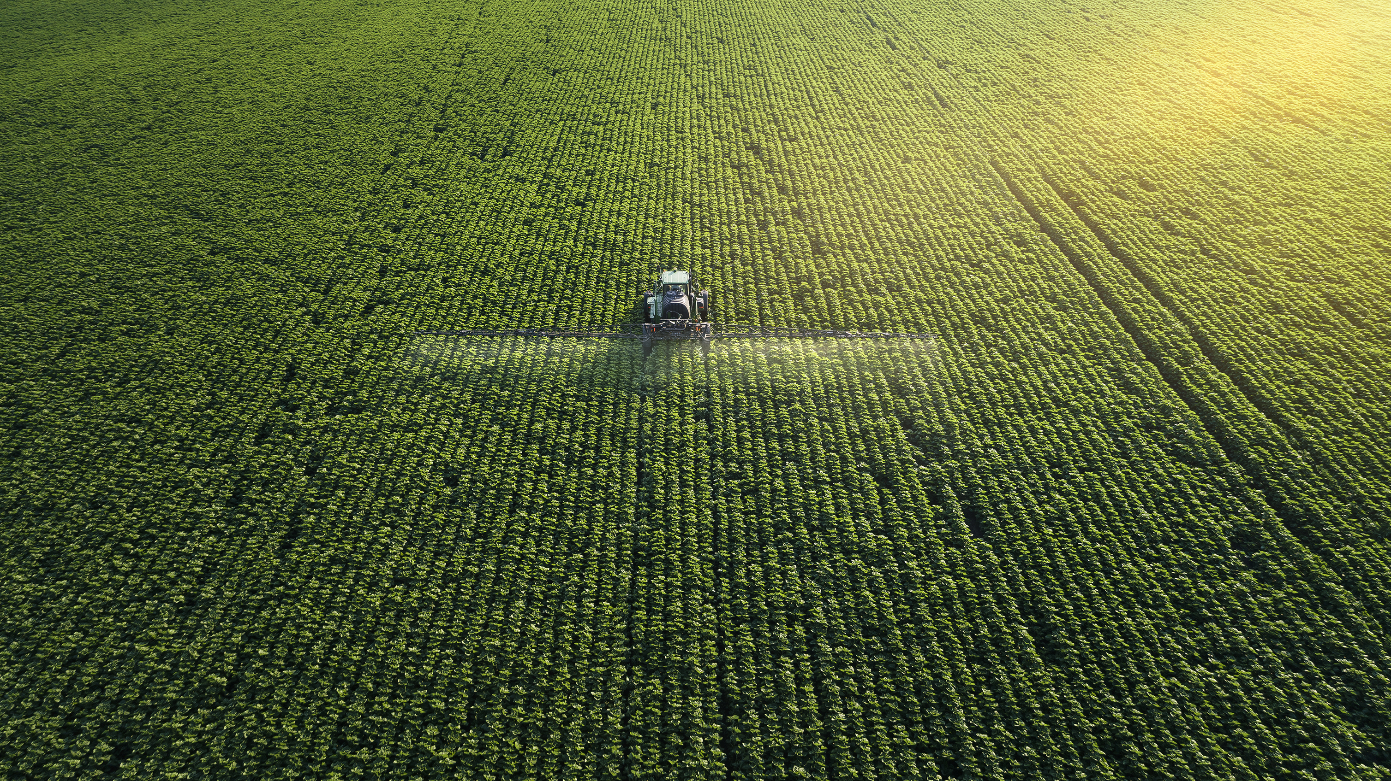
Agronomy CDE Resources
Insects/Diseases/Disorders:
ipmimages.org
Plant ID: Order ID sets from KSU Agronomy
Laminated or Taped, seed packets, and ID Book with tips & identifying features
Old Exams:
KSU Agronomy Department > K-12 Educators > FFA CDE
Lab Practical, Agronomic & Math Quizzes, Soil ID
https://www.agronomy.k-state.edu/outreach-and-services/k-12-educators/ffa-agronomy-career-development/guides.html
FFA CDE Order Form

Slide 5
Lab Practical Example Questions

Slide 6
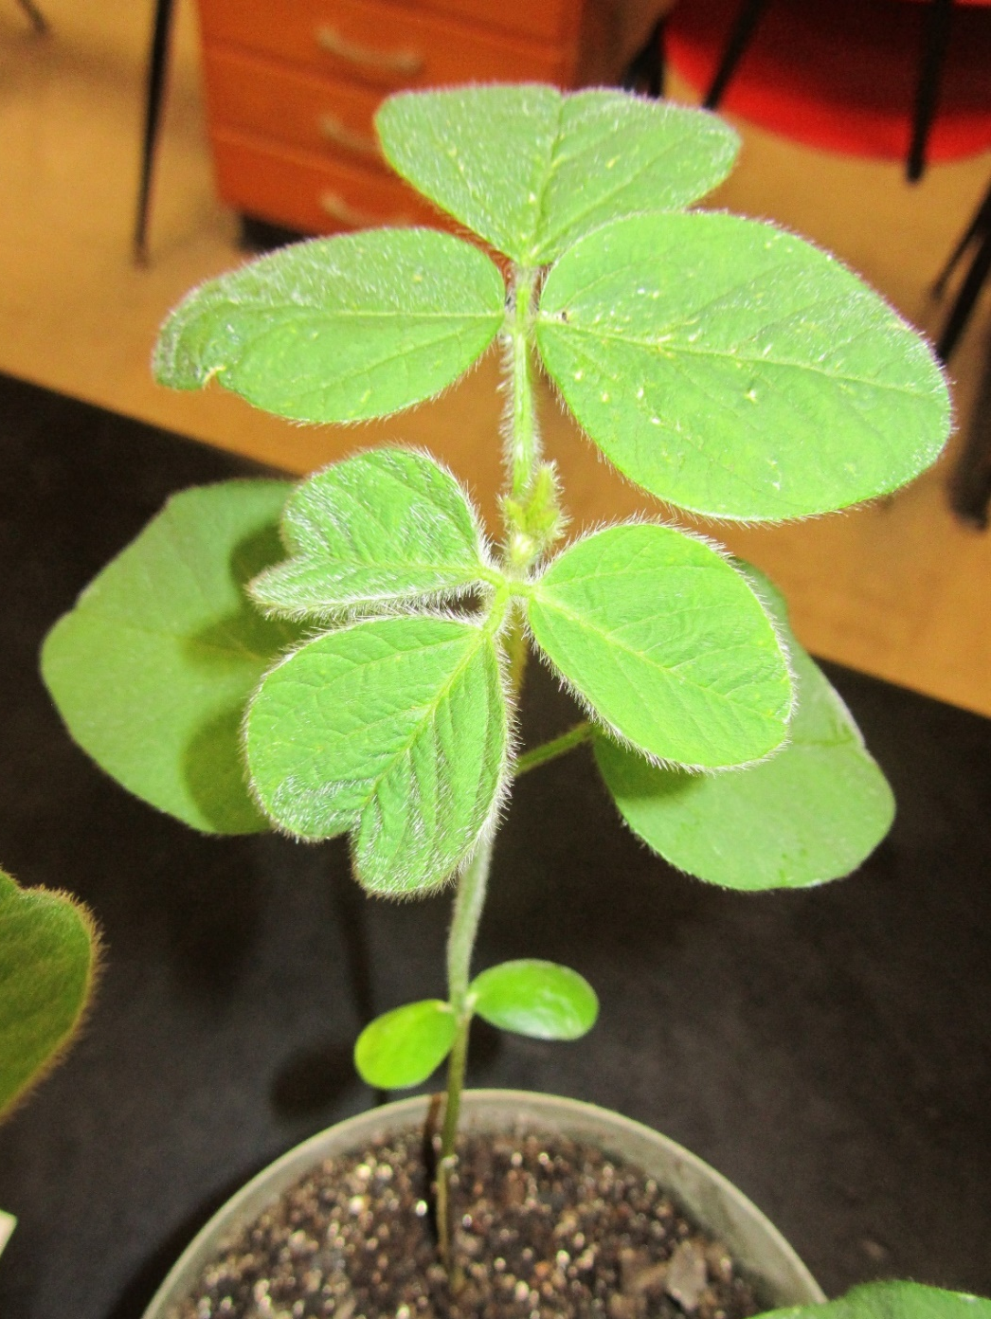
1. What is the developmental stage for this soybean plant?
A. V1
B. V2
C. V3
D. V4
E. V5

Slide 7
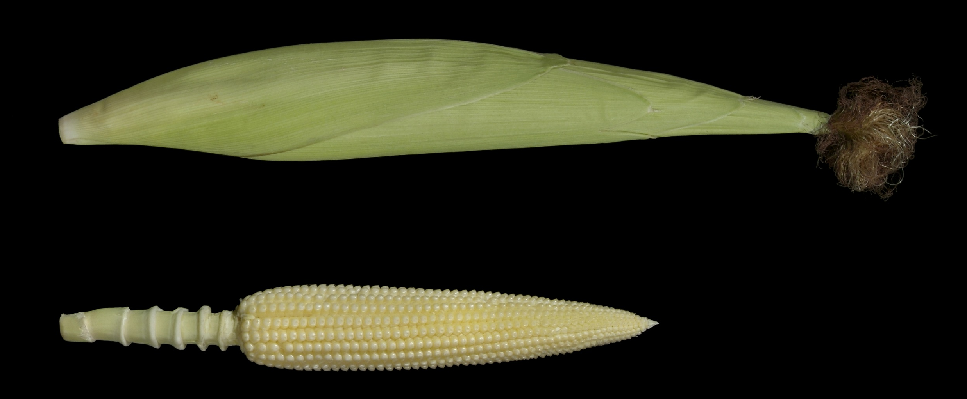
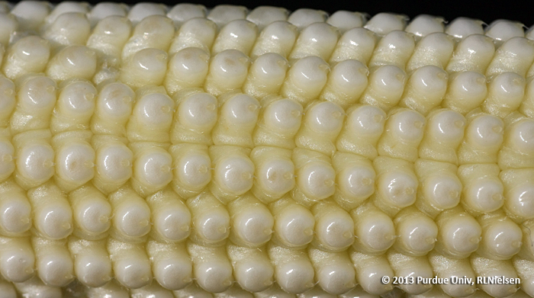
2. Two parts
a) What numerical reproductive stage is this corn at (letter and number)?
b) What is the descriptive term used to describe this stage?

Slide 8
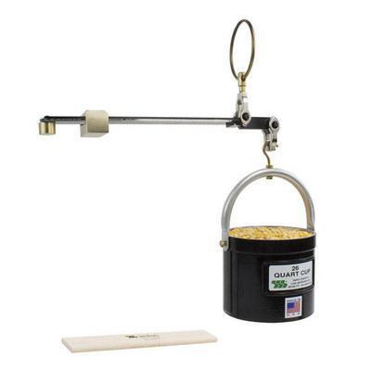
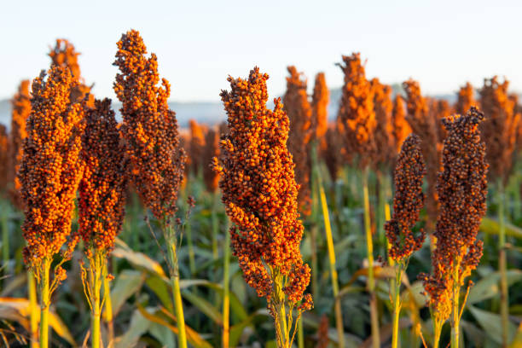
3. What is the standard bushel weight of this feed grain crop?

Slide 9
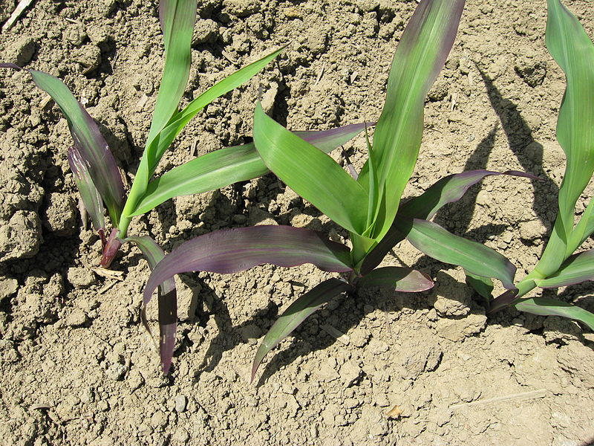
4. What nutrient deficiency is most likely the cause of the symptoms on these plants?
A. Iron B. Potassium C. Sulfur D. Nitrogen E. Phosphorus

Slide 10
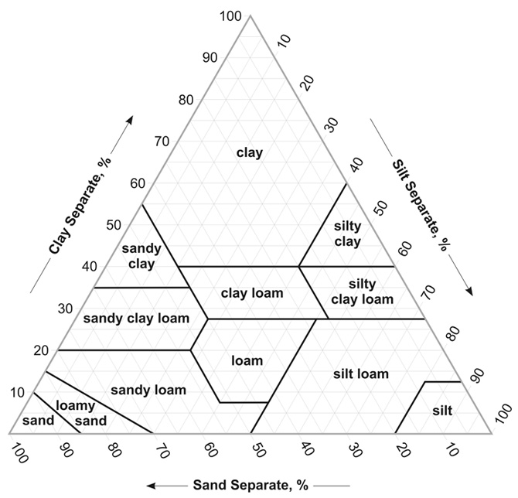
5. If a soil has 60% sand, 30% clay, and 10% silt, what is the soil texture?
A. Loam
B. Sandy clay loam
C. Sandy clay
D. Clay loam
E. Sandy loam
F. Silt loam

Slide 11
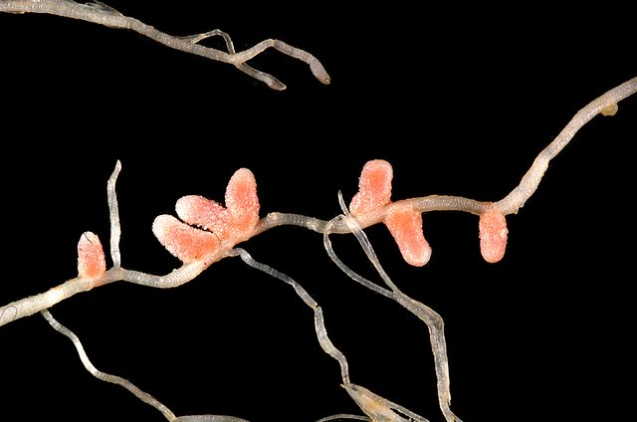
6. Shown here are legume root nodules from soybean and alfalfa. What is the name of the process in the nitrogen cycle that occurs in legume nodules that is so important to the growth and quality of legume crops?
A. Nitrification
B. Denitrification
C. Nitrogen Fixation
D. Volatilization
E. Immobilization

Slide 12
7. At standard 40 PSI pressure, what is the nozzle delivery rate of the sprayer nozzle tip on display? You must include appropriate units for full credit.

Slide 13
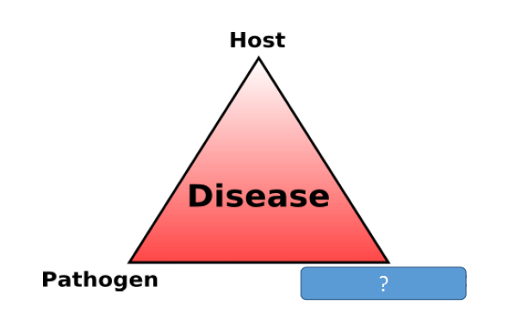
8. What is missing from the “disease triangle” shown?
A) Time
B) Vector
C) Alternate Host
D) Environment
E) Cropping System

Slide 14
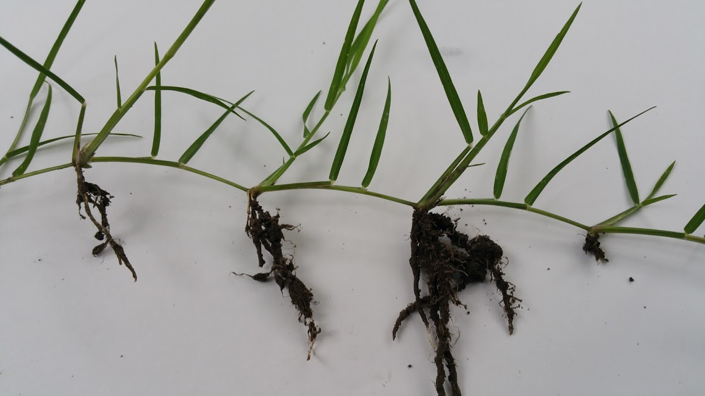
9. The botanical name of this structure from bermudagrass is a:
A. Stolon B. Tiller C. Rhizome D. Tuber E. Bulb

Slide 15
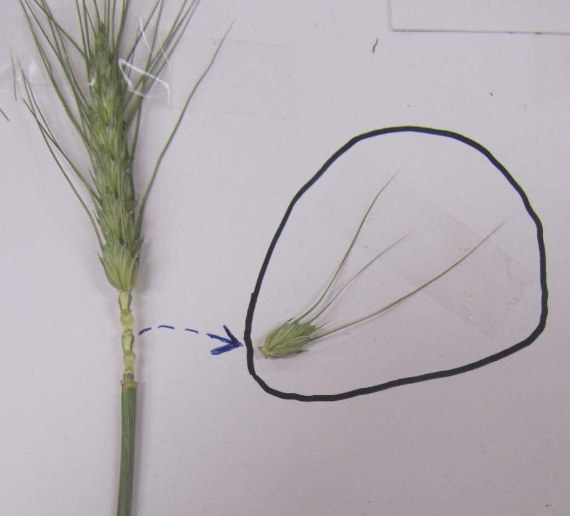
10. What is the botanical name of the entire structure within the circle that was removed from this wheat head? (It is the basic flowering unit of all grass plants)
A. spike
B. spikelet
C. floret
D. awn
E. petal
Close up view

Slide 16
11. Shown here are three standard tags that may be found on pedigreed seed regulated by state crop improvement associations. The correct order of generation of production for these three seed classes is:
A. Certified → Registered → Foundation
B. Foundation → Certified → Registered
C. Registered → Certified → Foundation
D. Foundation → Registered → Certified
E. Certified → Foundation → Registered

Slide 17
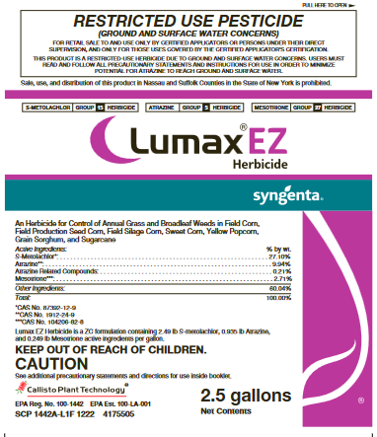
12. What is the “signal word” on this pesticide label?

Slide 18
13. What crop is this food product made from?

Slide 19
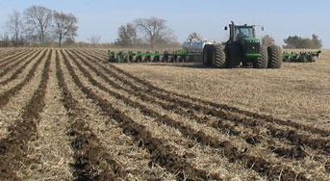
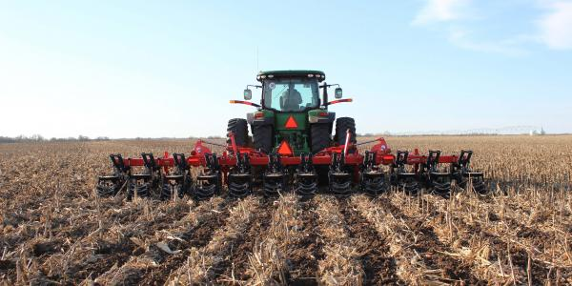
14. What is the specific name of the field operation being completed in these photos? (two words)

Slide 20
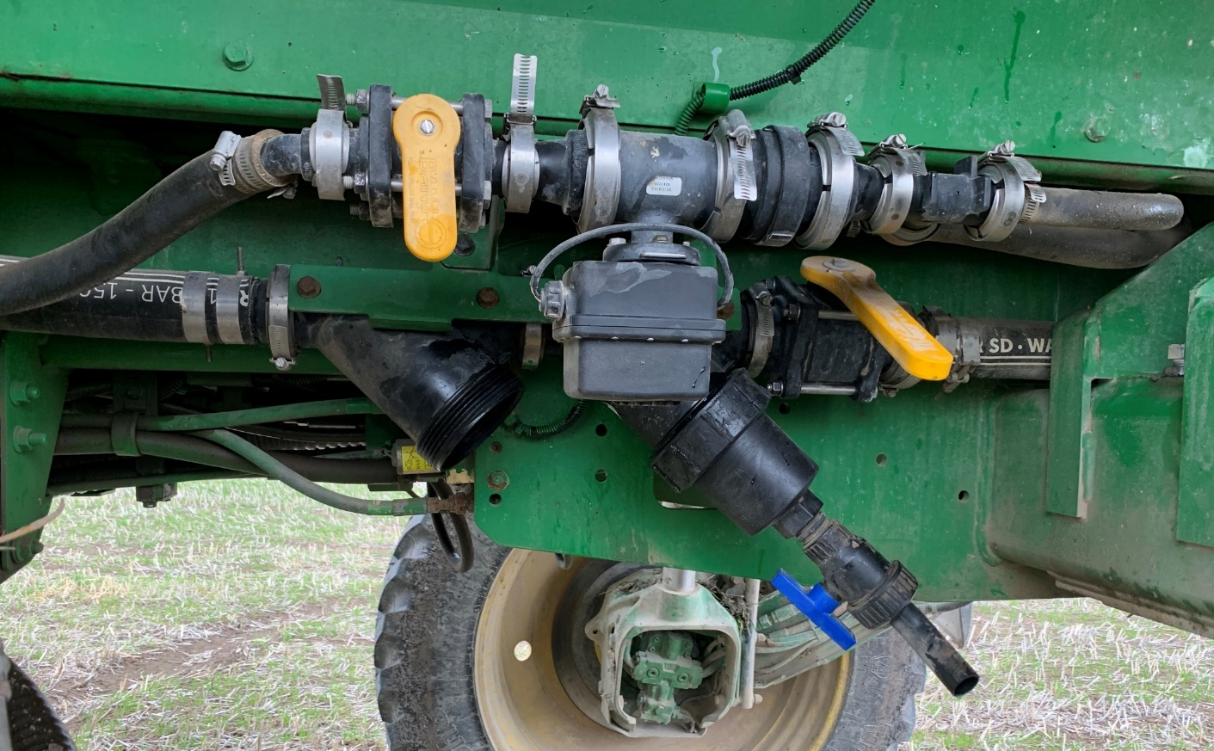
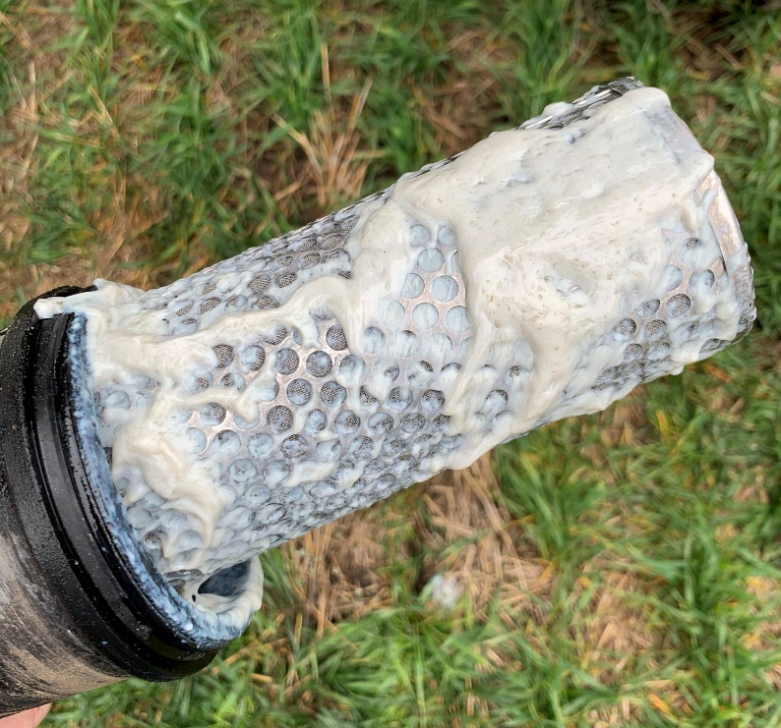
15. What was the most likely problem revealed by this photo? A) Incompatible mixture of different herbicide formulations B) Improper order of mixing different herbicide formulations C) Tank contamination from a previous application D) Incompatible mixture of herbicide with liquid fertilizer E) all of the above are possible causes

Slide 21
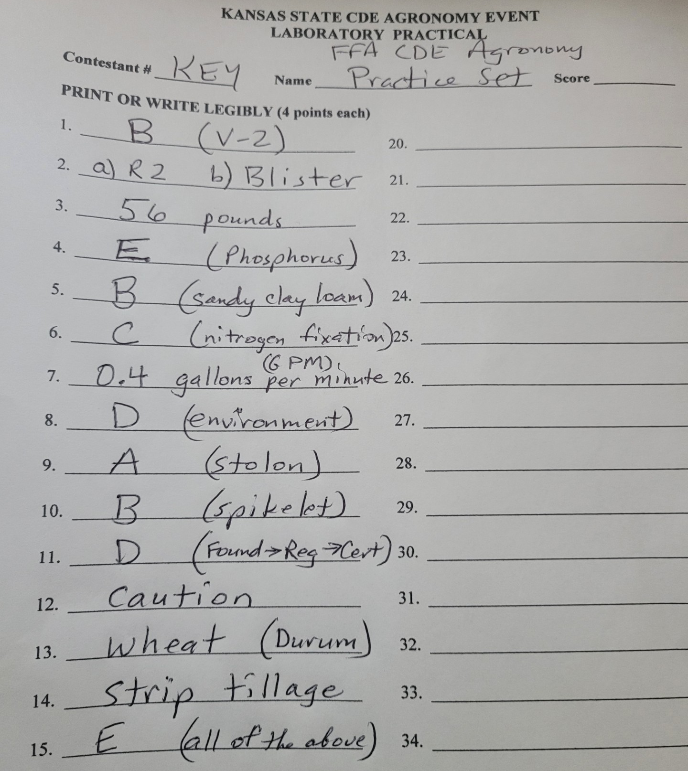

Slide 22
Math Example Questions

Slide 23
When determining plant stands for soybeans, you count an average of 31 soybean plants in 10 foot sections of row. Row width is 15 inches.
What is the population in plants per acre?

Slide 24
A farmer harvests a 69 bushels per acre wheat crop. Assume wheat averages 12% protein and
protein averages 16% nitrogen. Use the standard weight of 60 pounds per bushel for wheat.
Calculate the pounds of nitrogen removed per acre in the wheat grain.

Slide 25
After sending in a soil sample to the K-State Soil Testing Lab, you receive a recommendation to apply 93 pounds of K₂O per acre. Your field is 160 acres in size. If you have access to UAN (32-0-0), DAP (18-46-0), and potash (0-0-60) fertilizer.
How many tons of fertilizer will need to be applied to your entire field to fulfill the K₂O recommendation?

Slide 26
A spray tank has a volume of 750 gallons. The sprayer is calibrated to spray 15 gallons per acre. You are using a liquid formulation herbicide at the recommended rate of 32 fluid ounces of this herbicide product per acre.
How many gallons of this herbicide do you need to add to each tank?

Slide 27
Prior to harvest, you want to estimate the yield for your corn crop. You count an average of 24 ears in 17.4 ft lengths of row with 30-inch row spacing (1/1000 of an acre). The ears average 16 rows around and 42 kernels long. Assume 90,000 kernels per bushel.
What is the estimated yield in bushels per acre?

Slide 28
Answers

Slide 29
When determining plant stands for soybeans, you count an average of 31 soybean plants in 10 foot sections of row. Row width is 15 inches.
What is the population in plants per acre?
31 plants X 43,560 ft²
(10ft x 1.25ft) acre
108,028.8 plants/acre

Slide 30
A farmer harvests a 69 bushels per acre wheat crop. Assume wheat averages 12% protein and
protein averages 16% nitrogen. Use the standard weight of 60 pounds per bushel for wheat.
Calculate the pounds of nitrogen removed per acre in the wheat grain.
69 bu X 60 # x 12# protein x 16# N .
acre bu 100# wheat 100# protein
79.5 # N / acre

Slide 31
Your soil test recommends 93 pounds of K₂O per acre. Your field is 160 acres in size. If you have access to UAN (32-0-0), DAP (18-46-0), and potash (0-0-60) fertilizer.
How many tons of fertilizer will need to be applied to your entire field to fulfill the K₂O recommendation?
93# K₂O X 100 # potash x 160 acres x ton .
acre 60 # K₂O field 2000 #
12.4 tons/field

Slide 32
A spray tank has a volume of 750 gallons. The sprayer is calibrated to spray 15 gallons per acre. You are using a liquid formulation herbicide at the recommended rate of 32 fluid ounces of this herbicide product per acre.
How many gallons of this herbicide do you need to add to each tank?
750 gal spray X acre x 32 fl oz herb x gal herb .
tank 15 gal spray acre 128 fl oz herb
12.5 gal herbicide/acre

Slide 33
Prior to harvest, you want to estimate the yield for your corn crop. You count an average of 24 ears in 17.4 ft lengths of row with 30-inch row spacing (1/1000 of an acre). The ears average 16 rows around and 42 kernels long. Assume 90,000 kernels per bushel.
What is the estimated yield in bushels per acre?
24,000 ears X 16 rows x 42 kernels x bushel .
acre ear row 90,000 kernels
179.2 bushels/acre

